Slide 1




CatSat
Raquelle Denetso
Mentor: Dathon Golish
The University of Arizona
Hilton Tucson East
April 23, 2022

Slide 2
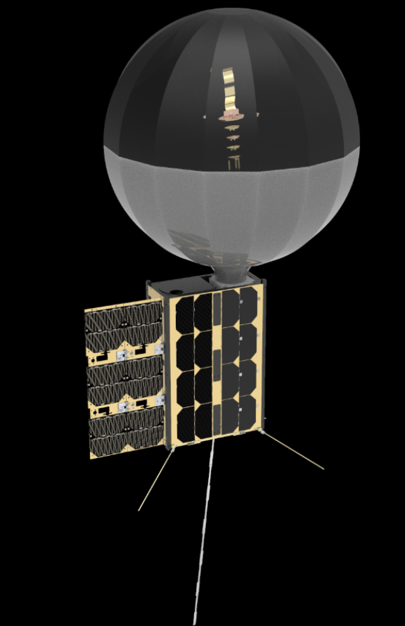
What is catsat?
CatSat is a 6U CubeSat.
A CubeSat is a small satellite.
CatSat will utilize inflatable antenna technology along with a weak signal propagation reporter (WSPR antenna).
The primary goal is to improve inflatable antenna signal technology.
The cable feed will have an inflatable antenna around it to boost the signal, allowing us to receive pictures from the CubeSat.
The purpose of the mission is to learn more and help develop this technology.
The secondary goal is to learn more about the ionosphere.
The WSPR antenna will use high frequency radio waves to study the ionosphere.
Inflatable antenna
WSPR antenna
CAD Model for CatSat

Slide 3
Concerns with cubesats
Overall weight of the CubeSat
CubeSats are small satellites so there needs to be a complete optimization of weight.
This criteria limits the capabilities of components and what the CubeSat can do (since a lot of the components can't be scaled down linearly).
Transmission strength of the antenna
The antenna on the CubeSat needs to be small and lightweight.
This criteria limits the signal strength and how much data can be transferred to and from the CubeSat.
Inflatable antenna technology is still new
Inflatable antennas are not fully developed and still need more research and experiments to develop.
This criteria limits us from creating defined requirements and expectations for this experiment.

Slide 4
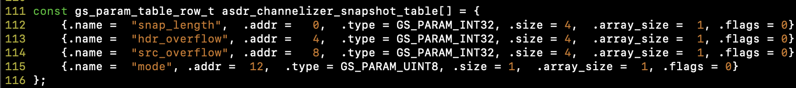
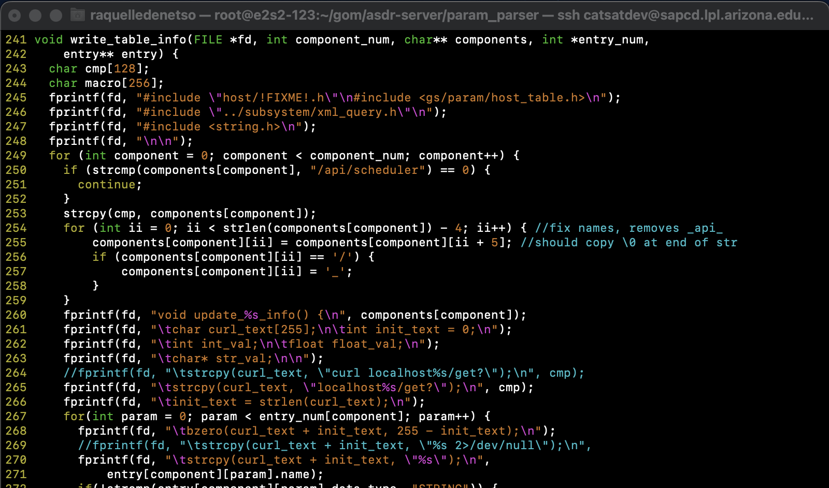
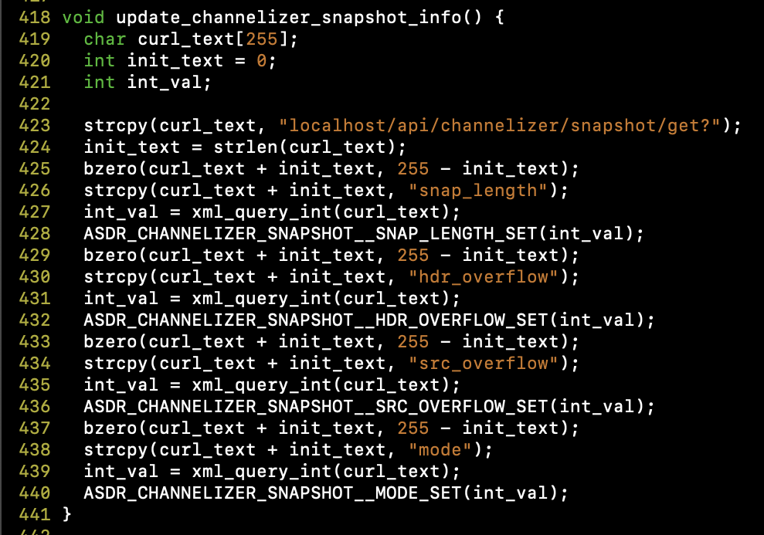
Catsat breakdown- software
Example of the function that writes the parameter tables.
Focused on pulling information from the CubeSat to monitor the status of the components and collect data for the experiments.
My work with the software:
Parameter tables (housekeeping functions, Scripts)
Communication with the temperature sensors (I2C Protocol)
Coding in C, along with using a Linux environment

Slide 5
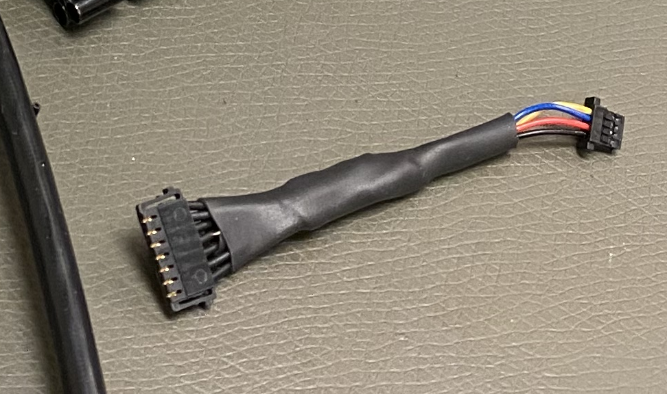
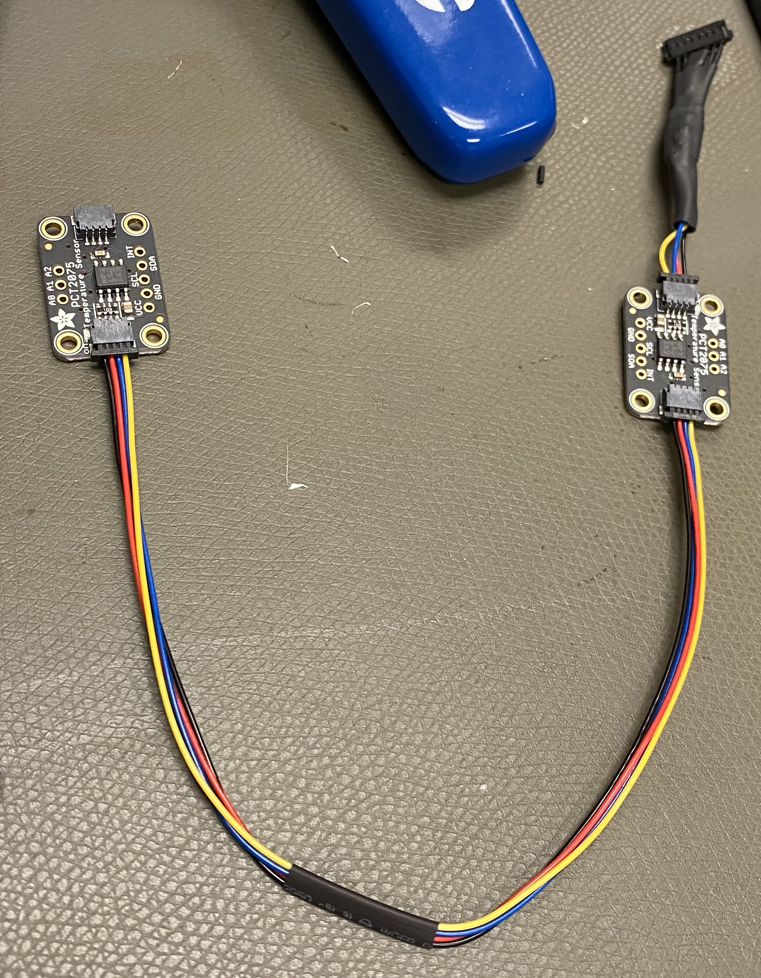
Catsat breakdown- hardware
Focused on inflating and deploying the antenna and making sure it stays inflated while in space.
Testing the hardware to verify it can withstand the space environment and will operate properly.
My work with the hardware:
Assisting with creating cables to connect software components.
Picture above is one of the cables we made for the temperature sensors. The picture to the right is how the cable will connect these sensors to the microcontroller.

Slide 6
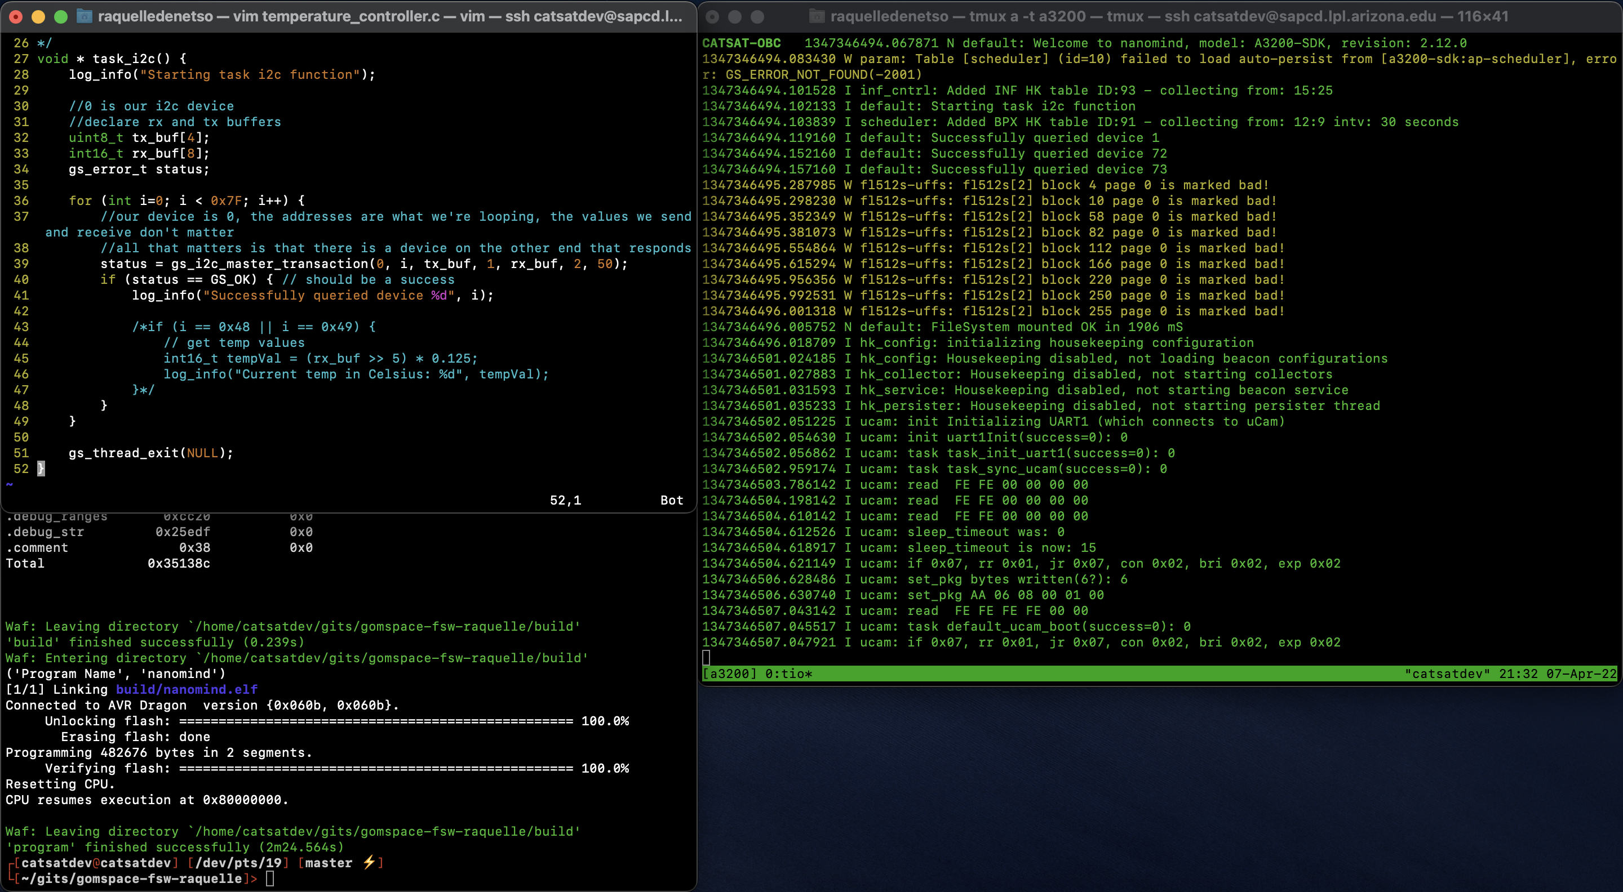
results
Expected results:
The software is expected to output the status of system every so often and receive data from the CubeSat.
We are expected to receive photos from the metrology camera onboard. The antenna is expected to boost the signal enough to receive these photo packets.
The WSPR antenna will give us a chance to learn more about the ionosphere using these high frequency radio waves.
Example of what we see when outputting some of the data.

Slide 7
significance of results
If we successfully get pictures from CatSat, we can eventually develop to getting better quality pictures and videos and transmitting more data.
Proves that inflatable antenna technology is feasible and can be a viable resource for smaller satellites.
Also demonstrates the capabilities of inflatable antenna technology and gives us a chance to build our knowledge on it.

Slide 8
acknowledgements
I would like to thank my mentor Dathon Golish, along with Del Spangler.
I also would also like to thank the CatSat team and the Arizona Space Grant Consortium for this opportunity.

Slide 9
Thank you

